Slide 1
Fast Implementation of DGEMM on Fermi GPU∗
Guangming Tan†, Linchuan Li†, Sean Triechle‡, Everett Phillips‡, Yungang Bao†, Ninghui Sun†

Slide 2
main contributions
formulate a performance model to select an optimal algorithm for blocking matrix multiplication on the Fermi architecture.
three optimization strategies to exploit the potential of Fermi’s computing capability.
an experimental experience on tuning DGEMM code on the Fermi architecture.

Slide 3
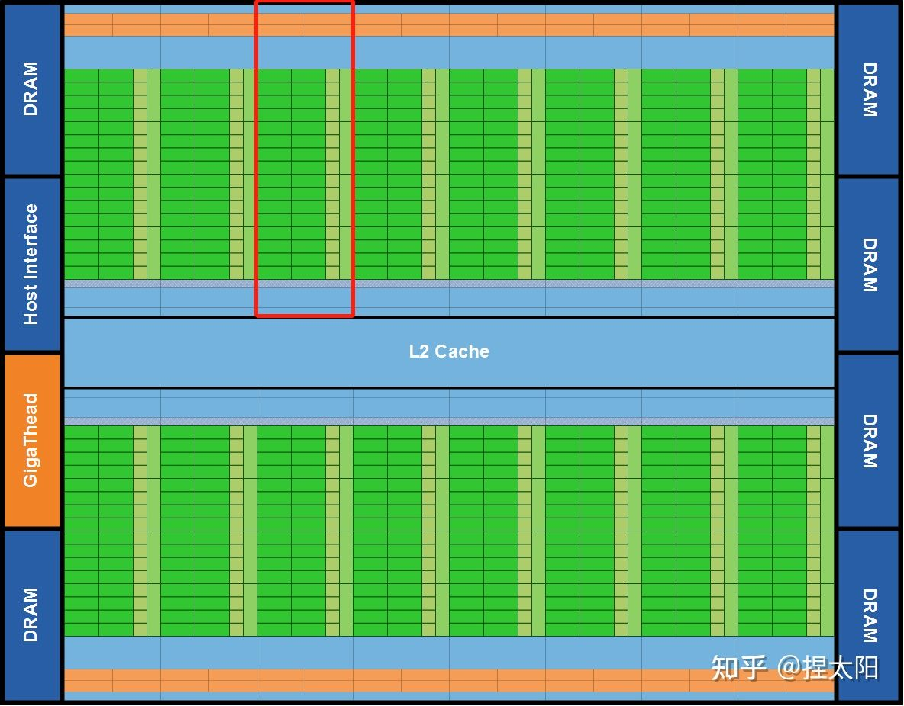
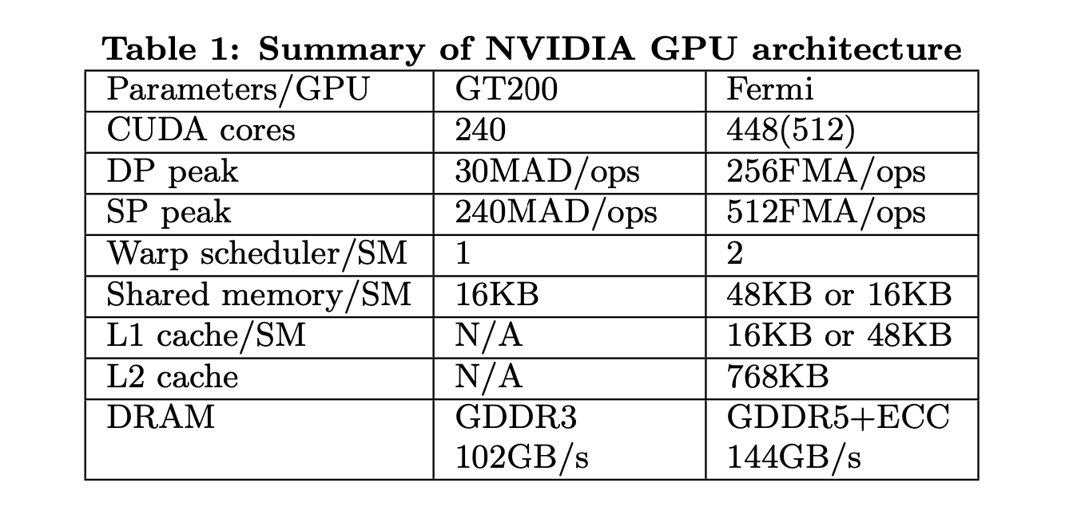
Fermi GPU Architecture
1.03Tflop/s single-precision operations and 515Gflop/s double-precision operations.

Slide 4
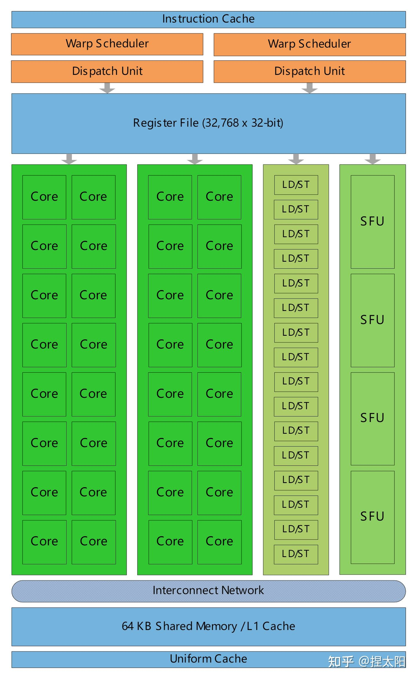
Fermi GPU Architecture
The size of shared memory is increased to 48KB while it may be configured with 16KB.
the number of banks of shared memory increases to 32.
A cache hierarchy is added between DRAM and streaming cores.
There are two warp schedulers for each SM.
wider load/store operations than 32-bits per thread, both 64- and 128-bits memory operations.

Slide 5
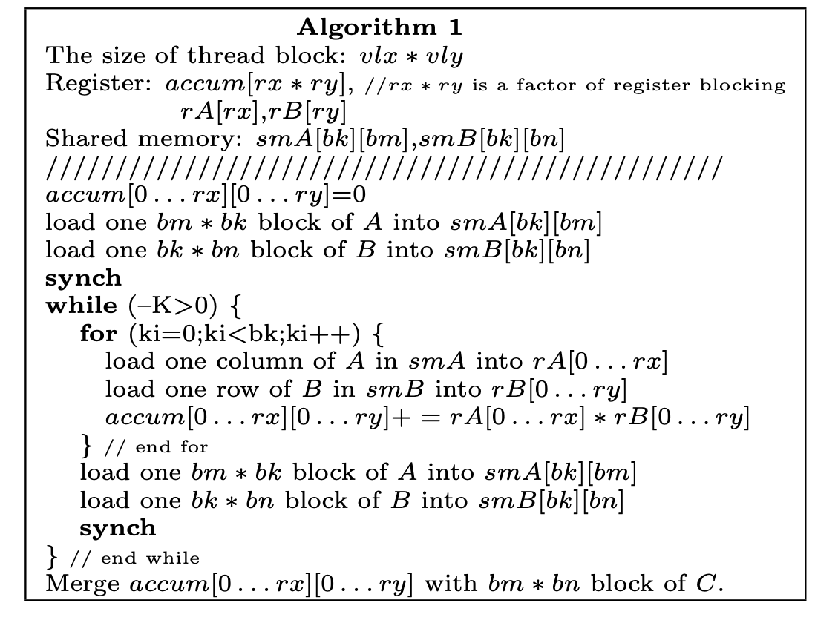
DGEMM on GPU
C := alpha∗A∗B+beta∗C
block global memory read:
M∗N∗K∗bm∗bk+M∗N∗K∗bk∗bn =
m∗n∗k∗(1/bm+1/bn)
where M = m/bm, N = n/bn, K = k/bk
bandwidth reduction of 2/(1/bm + 1/bn)
RB = DF ∗ W B ∗ 1/S =
(DF ∗ W B) ∗ (1/bm + 1/bn)/2
RB = (DF ∗ W B) ∗ (1/bn) < BW

Slide 6
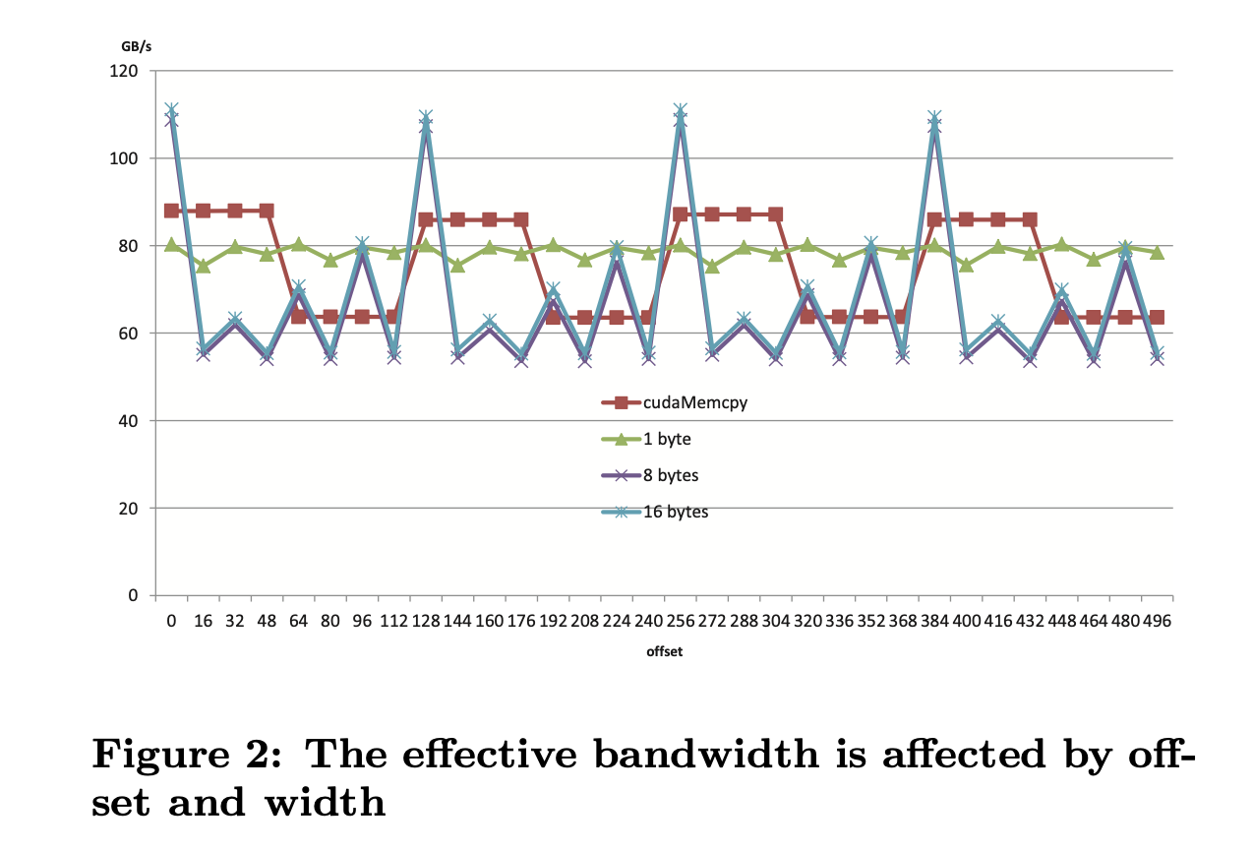
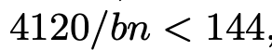
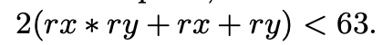
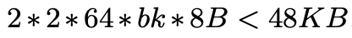
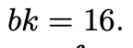
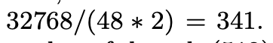
DGEMM on GPU
2 thread blocks, 2 * 192 threads on one sm to hide latency

Slide 7
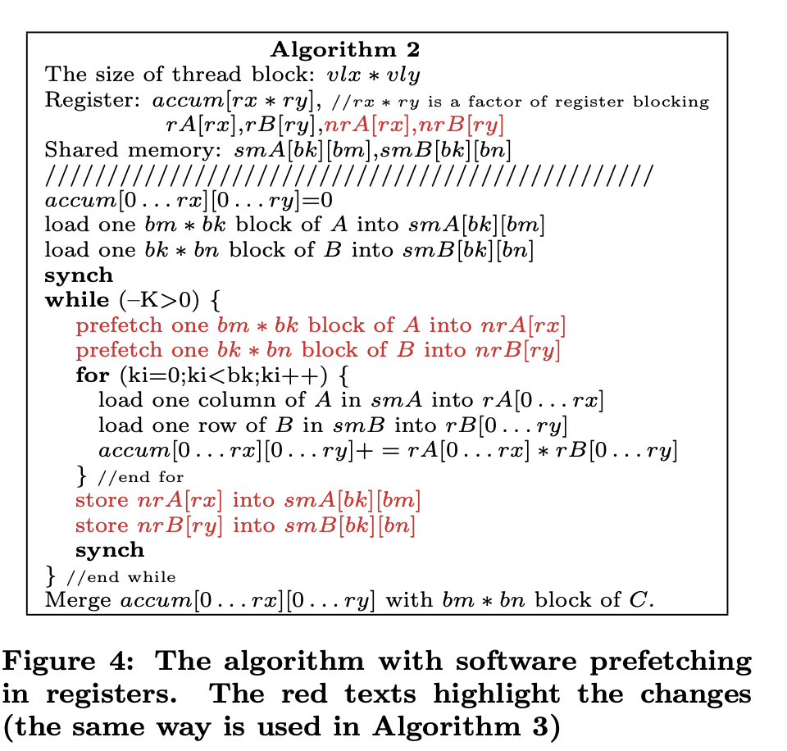
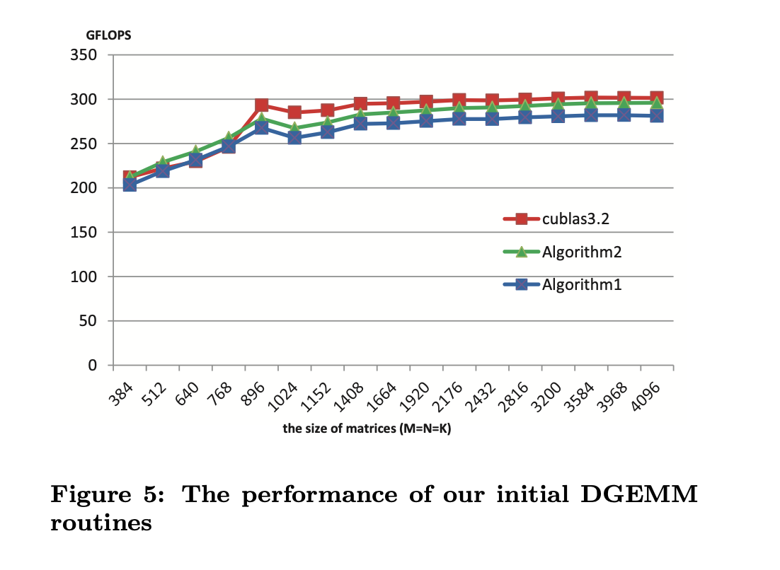
DGEMM on GPU

Slide 8
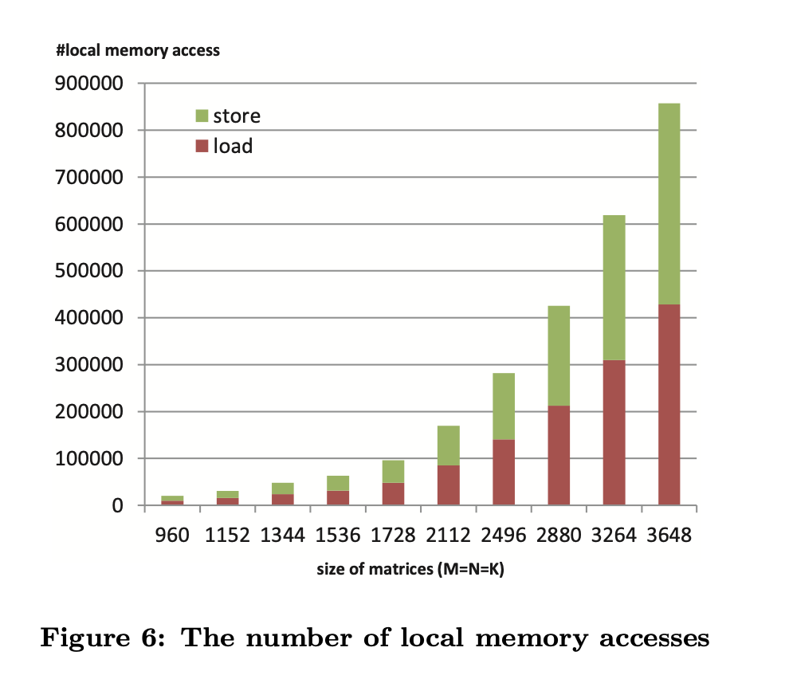
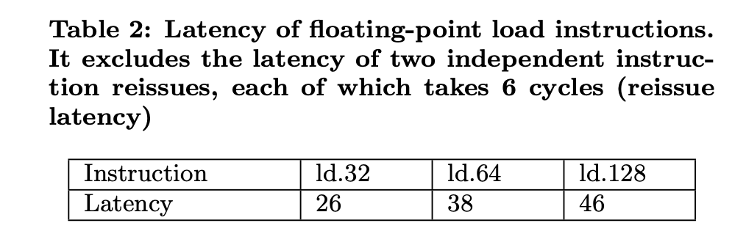
DGEMM on GPU
256/(128 + 8 + 8 + 256) = 64%
256/(64 + 4 + 4 + 256) = 78%

Slide 9
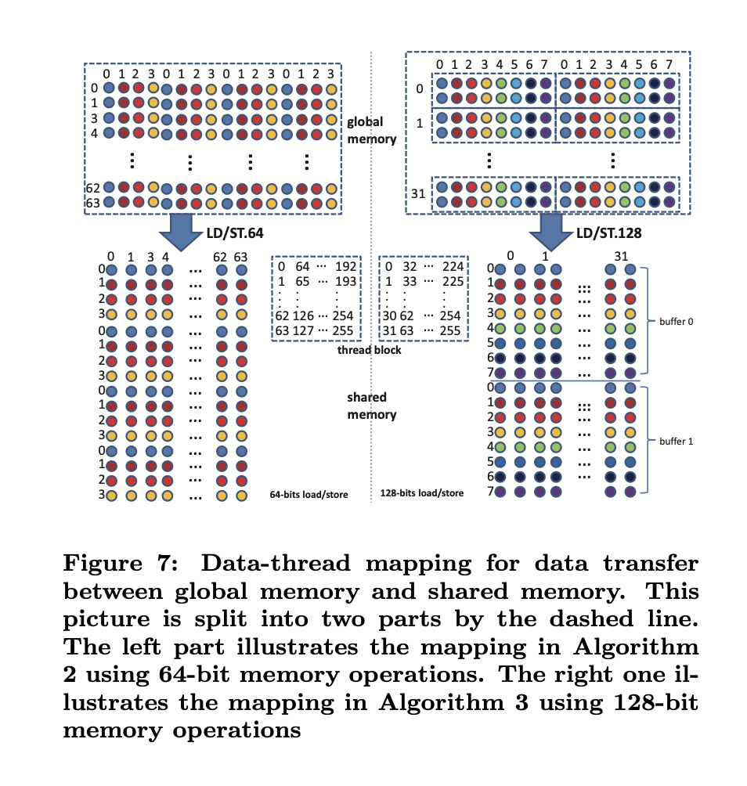
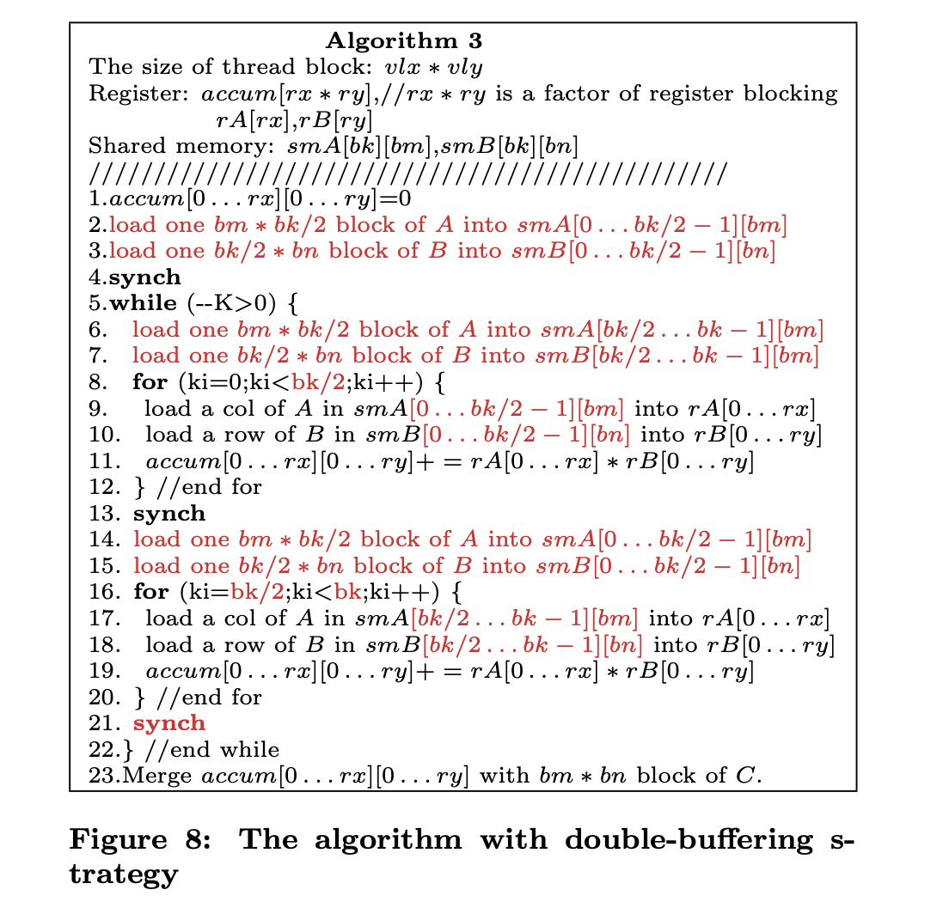
DGEMM on GPU

Slide 10
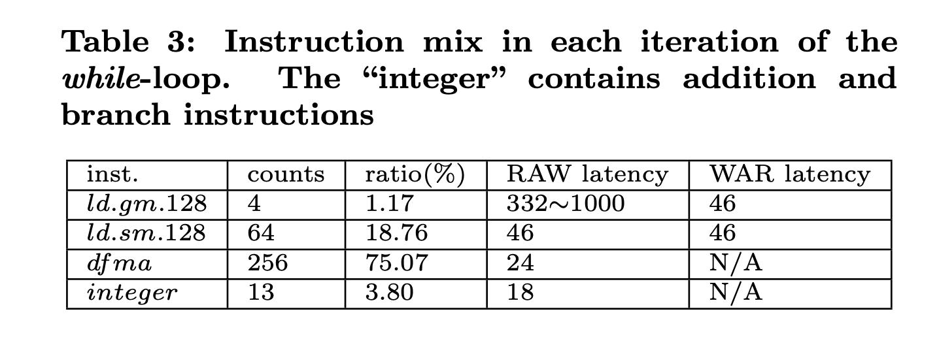
DGEMM on GPU

Slide 11
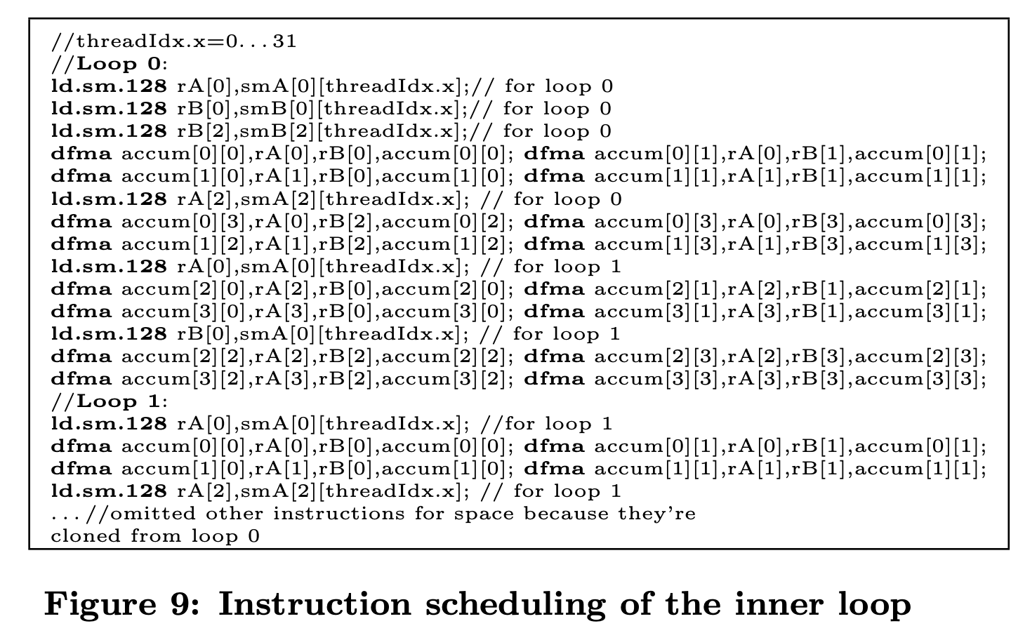
DGEMM on GPU

Slide 12
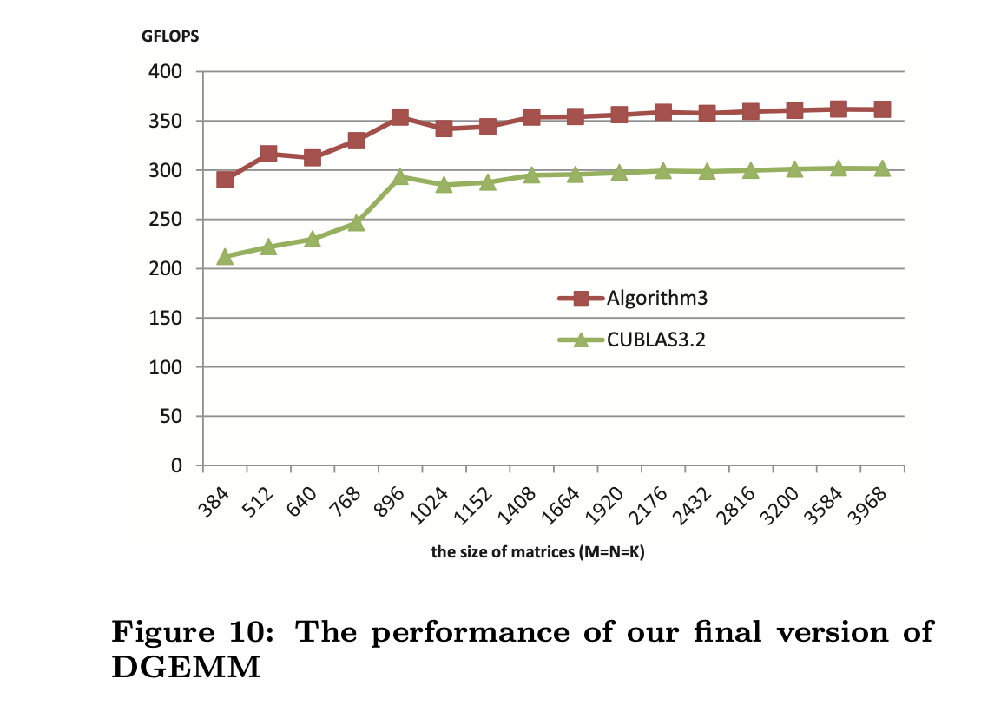
Performance
70% peak performance
20 improvements compared with cublas

Slide 13
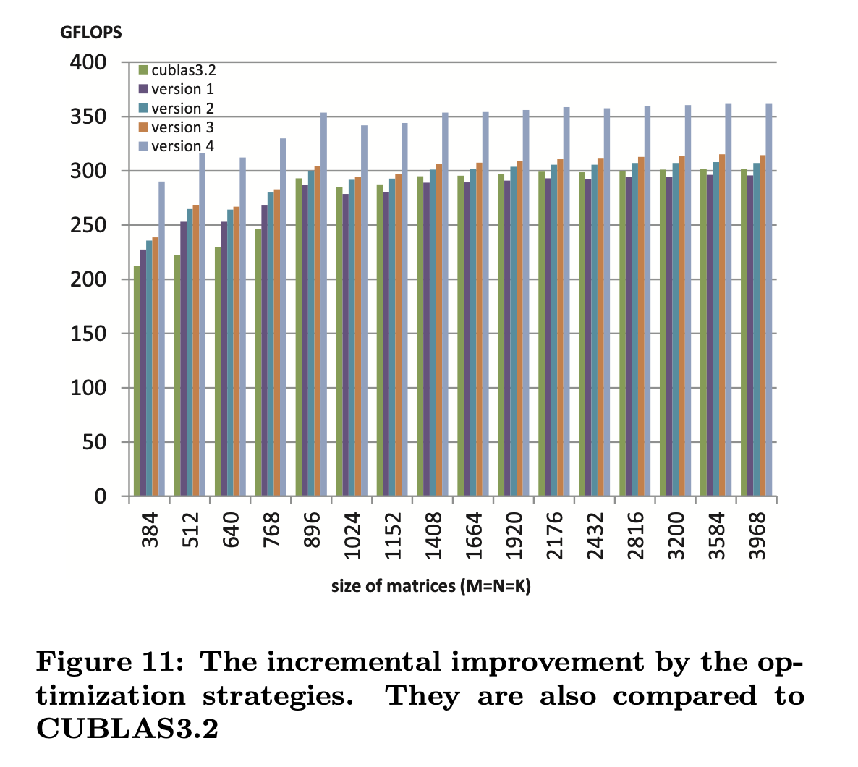
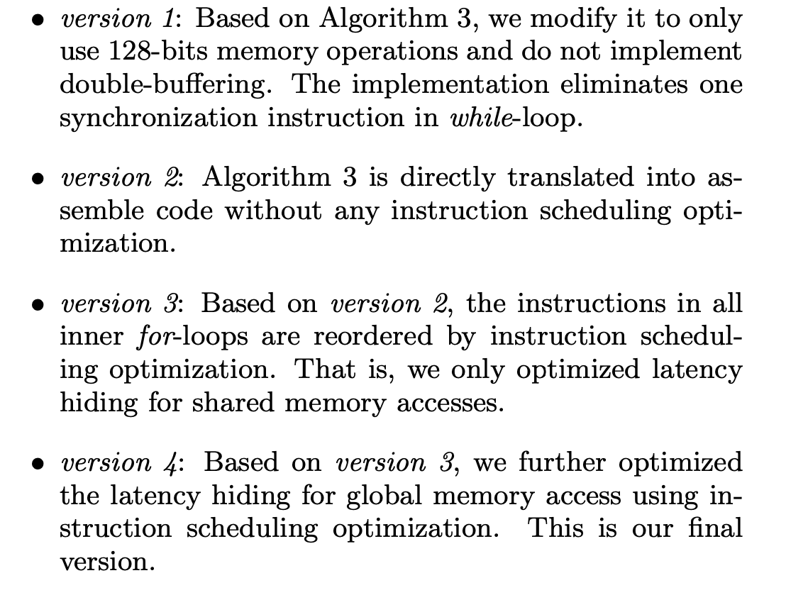
Performance

Slide 14
Architectural Impact
Increasing the number of registers per thread.
Increasing shared memory bandwidth.
Increasing instruction throughput.
More efficient instruction scheduler.

Slide 15
THANKS!

